Slide 1
YIELD PER RECRUIT AND SPAWNING STOCK BIOMASS PER RECRUIT MODELS AND THE RESULTING REFERENCE POINTS USED IN FISHERIES MANAGEMENT
Joseph T. DeAlteris
University of Rhode Island
Kingston, RI

Slide 2
Presentation Outline
Use of YPR and SSBPR Models
Biological Parameters
Characteristics of Unfished Cohort
Fishery Parameters
Characteristics of Fished Cohort
YPR Models
SSBPR Models
Reference Point Definitions: Limit vs. Target
Reference Points from ASMFC Stock Assessments
Sensitivity of Reference Points to Model Input Parameters
Summary and Conclusions

Slide 3
YPR and SSBPR models are used to predict:
The effects of alterations in harvesting activity on the yield from a given cohort, and the spawning stock biomass remaining as compared to the unfished spawning stock biomass.
Provide reference points for fisheries management.

Slide 4
Factors Utilized in the
YPR and SSBPR Models
Biological - growth, maturity, and natural mortality.
Harvesting - age or size at entry into the fishery and fishing mortality.

Slide 5
Methods Used in the
YPR and SSBPR Model
YPR - Beverton-Holt analytical solution
      Discrete-Time Model
SSBPR - Discrete-Time Model

Slide 6
Biological or Life History Parameters
K is the instantaneous growth coefficient.
M is the instantaneous natural mortality coefficient.
W∞ is the maximum weight an individual fish may attain, based on L∞ and a-b coefficients.
Specified maturity schedule.

Slide 7
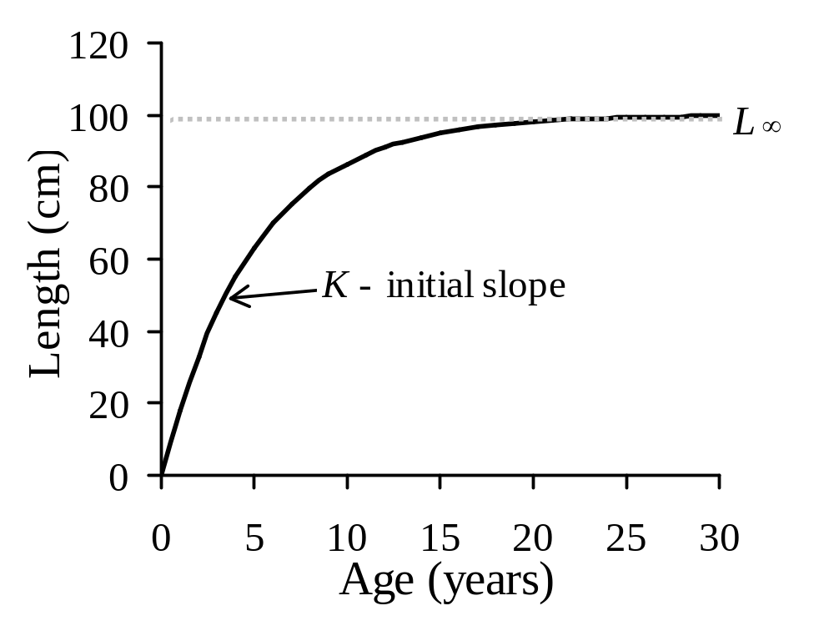
Von Bertalanffy Growth Function (Length)

Slide 8
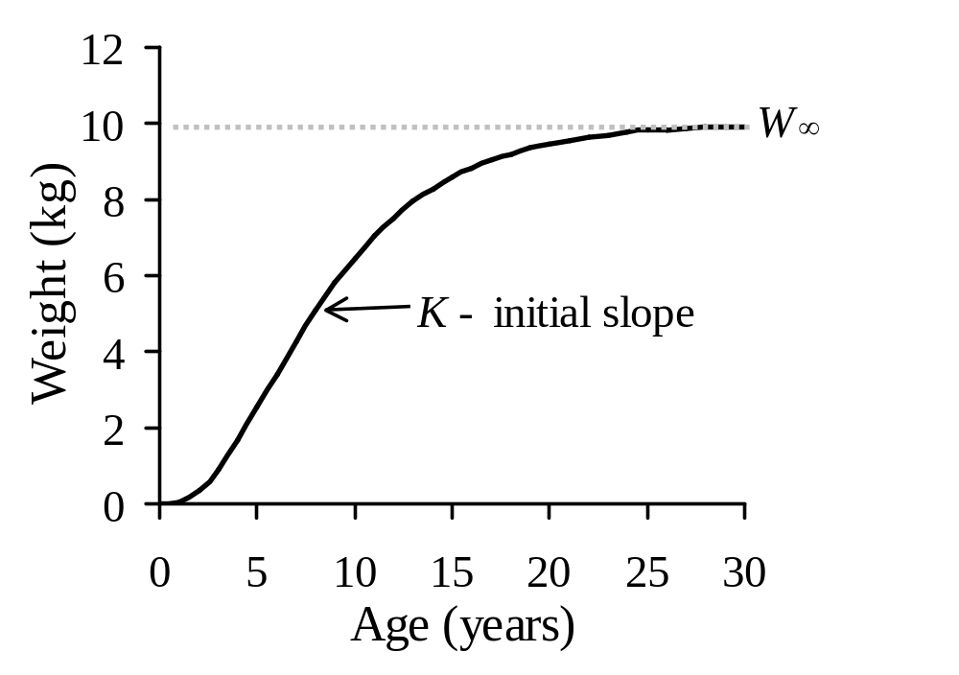
Von Bertalanffy Growth Function (Weight)

Slide 9
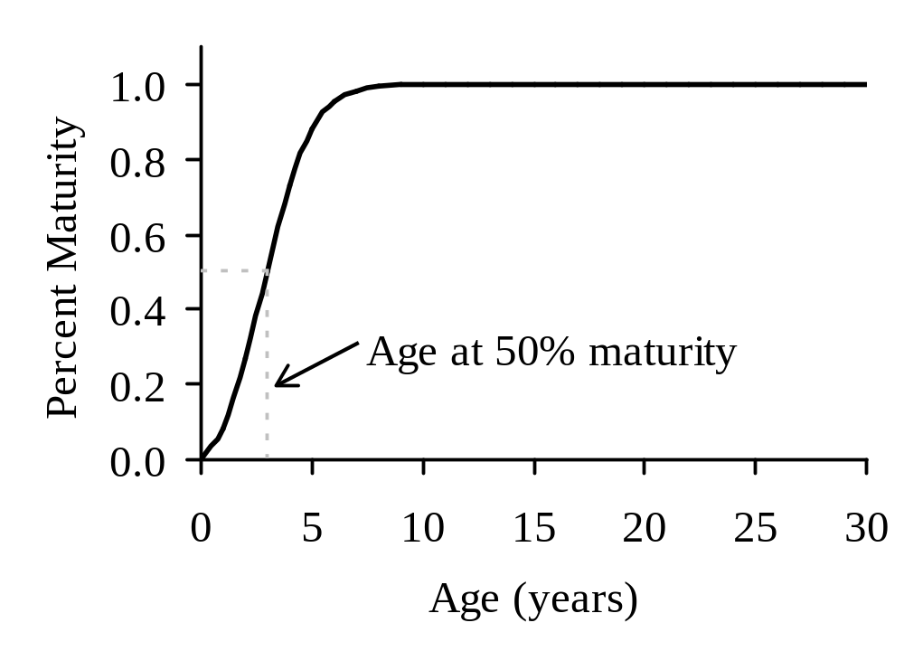
Maturity as a Function of Age

Slide 10
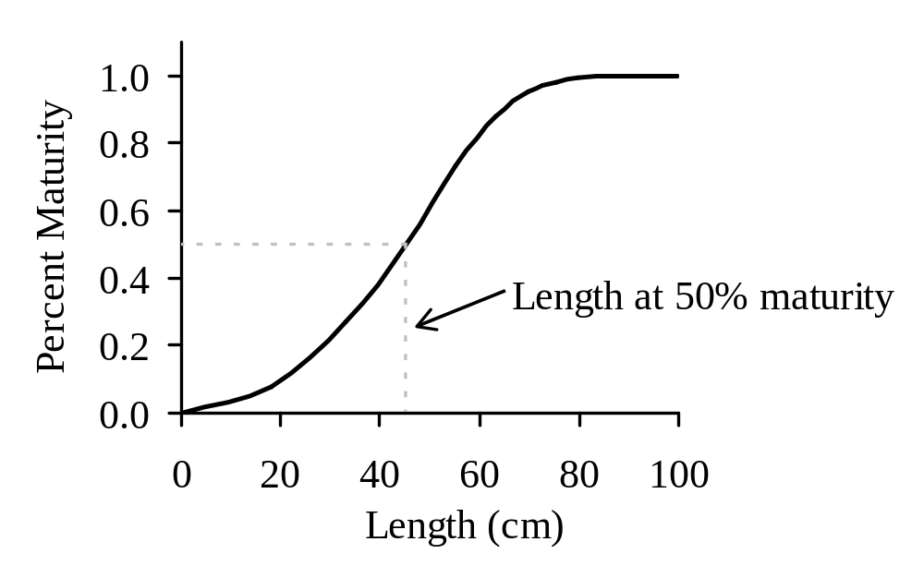
Maturity as a Function of Length

Slide 11
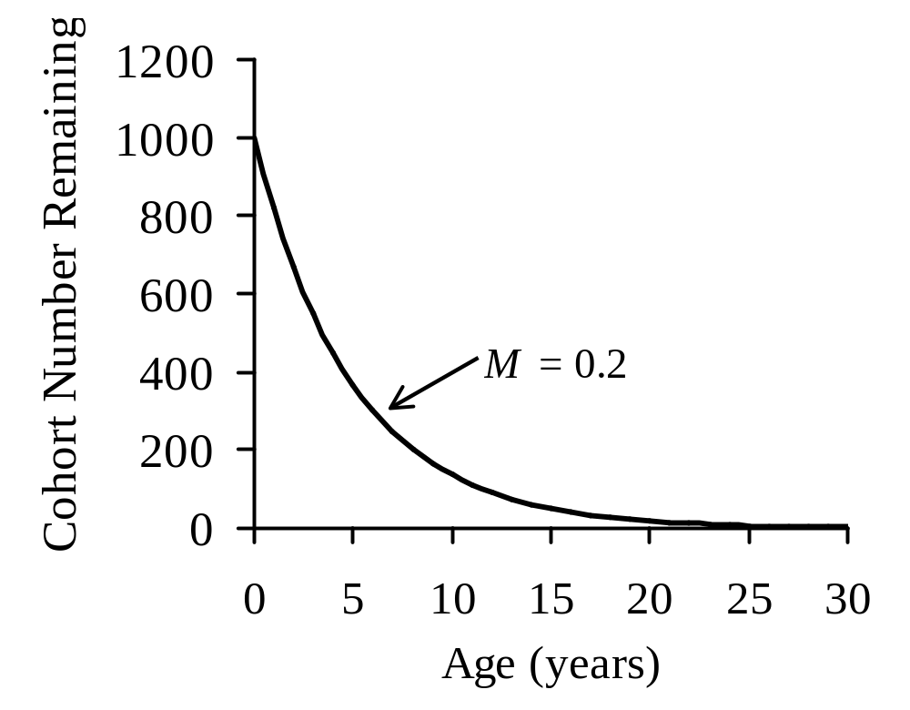
Exponential Decay Mortality Function
(18% Annual Loss)

Slide 12
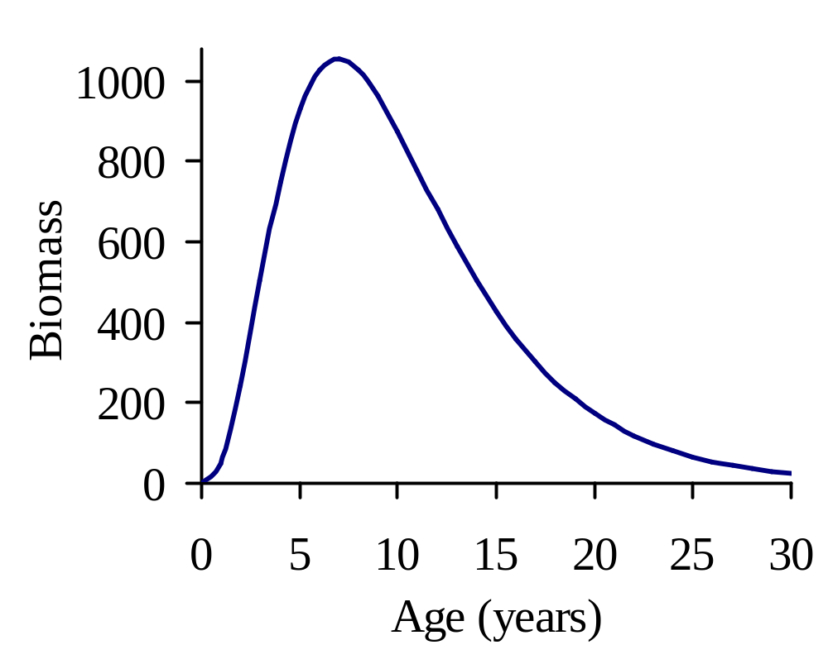
Cohort Biomass as a Function of Age
(Cohort Biomass = Ind. Weight x Cohort Numbers)

Slide 13
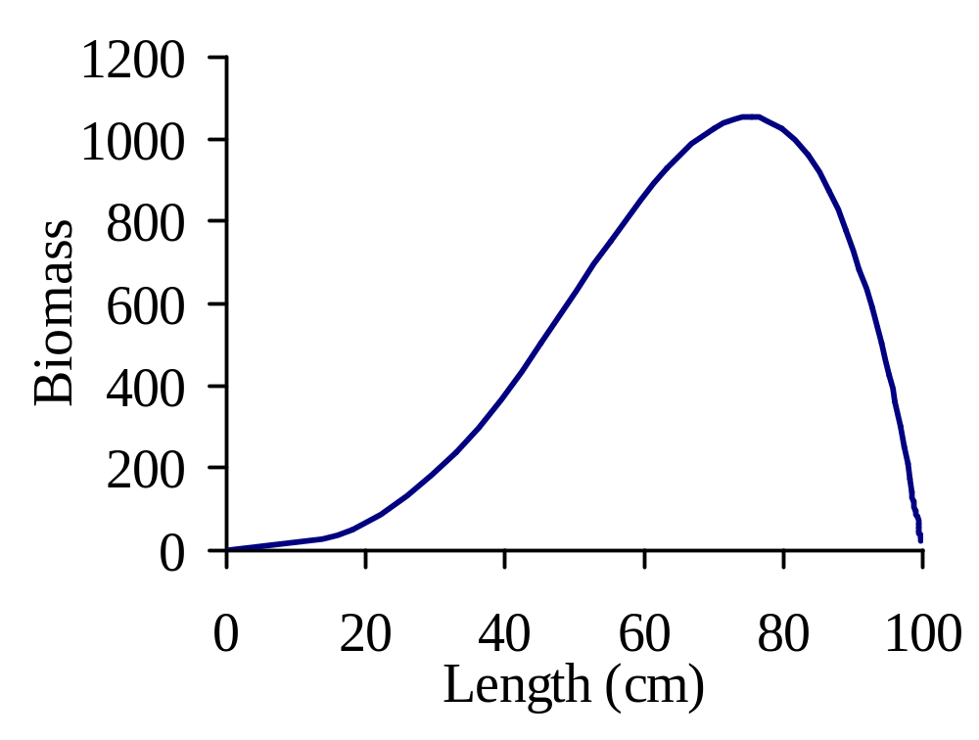
Cohort Biomass as a Function of Length

Slide 14
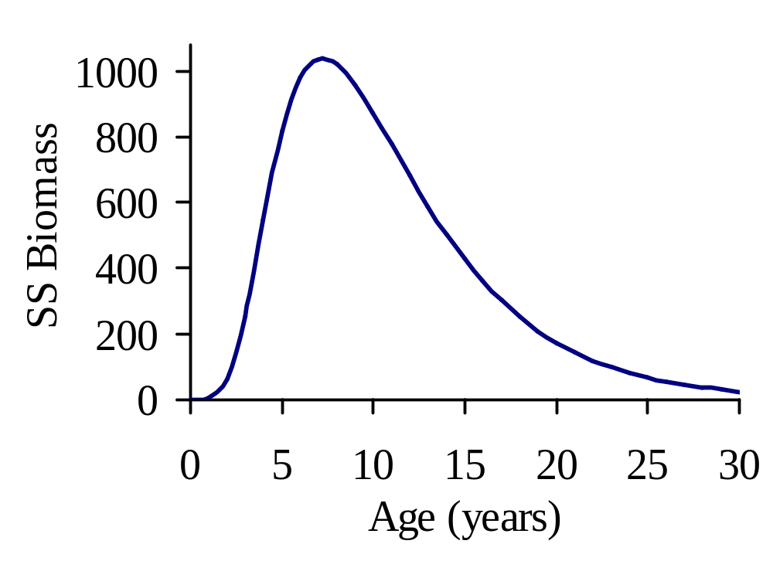
Spawning Stock Biomass as a Function of Age

Slide 15
Fishery Parameters
Susceptibility to harvesting gear: t_{c} is the age at which fish enter the fishery in the analytical B-H model or P is the probability of retention or capture in the discrete time model.
F is the instantaneous fishing mortality coefficient (rate of harvest).

Slide 16
Application of Fishing Mortality:
Age or Size of Entry into the Fishery
Knife edge selection - instantaneous full recruitment to fishery.
LCDF or NPDF size selection, partial recruitment to the fishery possible.

Slide 17
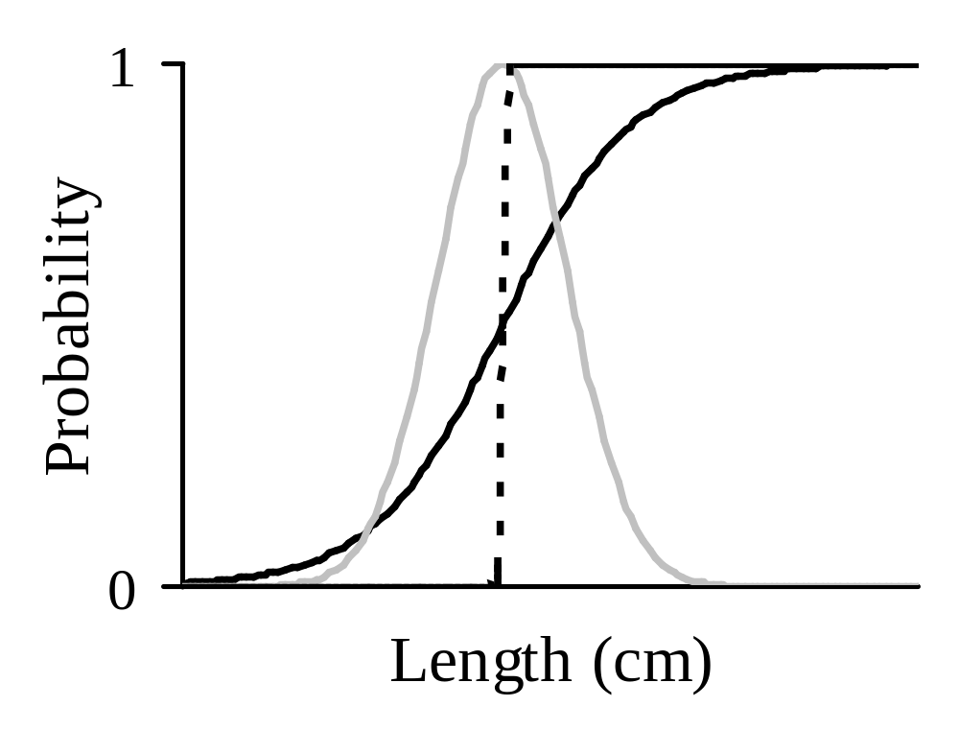
Size Selection Processes
LCDF
NPDF
KNIFE EDGE SELECTION

Slide 18
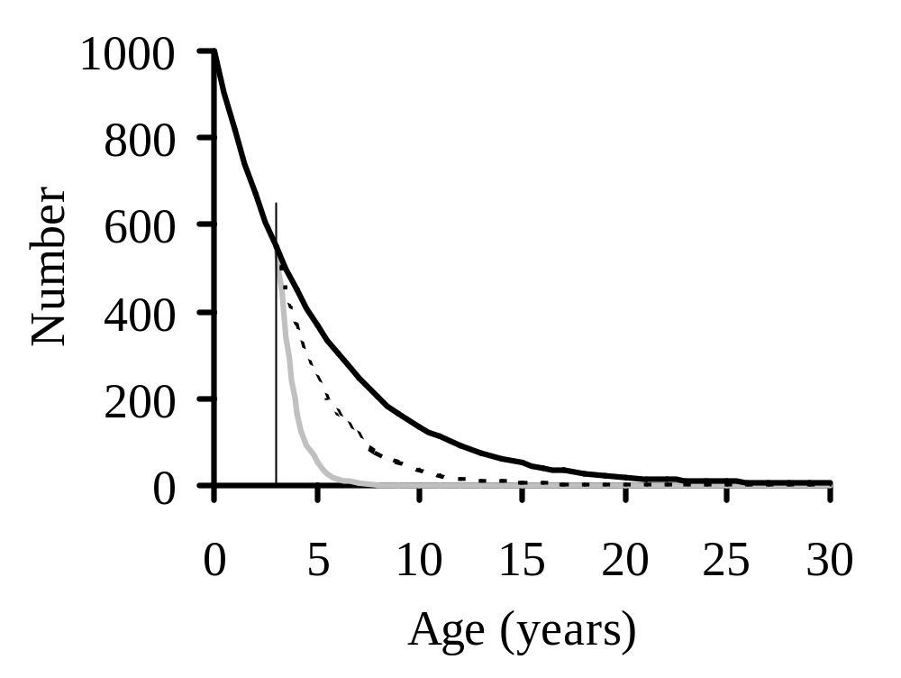
Effect of Fishing Mortality on Cohort Number as a Function of Age
M = 0.2 (82% Annual Survival)
t_{c} = 3
F = 0.2 (66% Annual Survival)
F = 1.0 (30% Annual Survival)

Slide 19
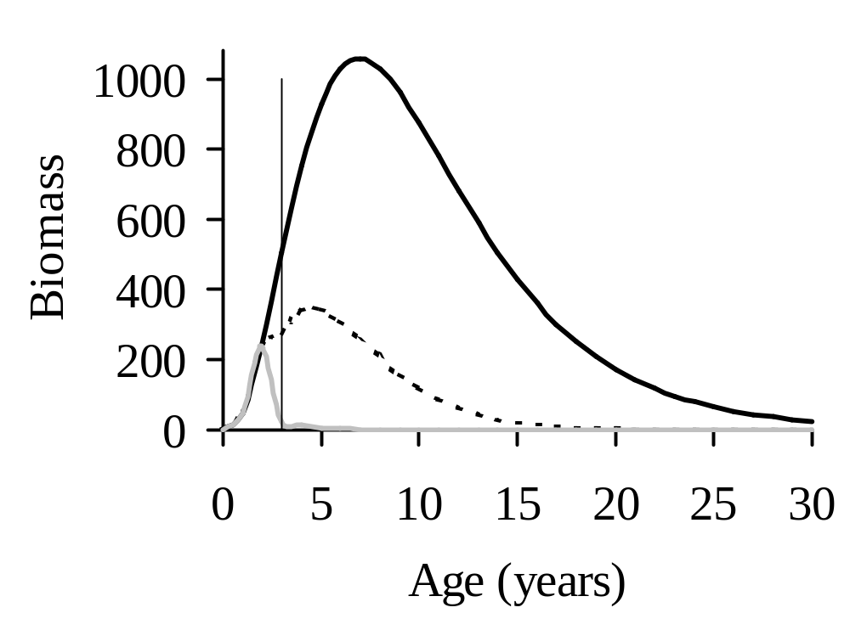
Effect of Fishing Mortality on Cohort Biomass as a Function of Age
t_{c}
M = 0.2
F = 0.2
F = 1.0

Slide 20
YPR Models
Yield or catch is removed annually from the cohort biomass.
Total yield or catch is a function of F (fishing mortality rate) and age of entry into fishery.
YPR is the summed yield resulting from each year of the cohort’s existence divided by the number of recruits.

Slide 21
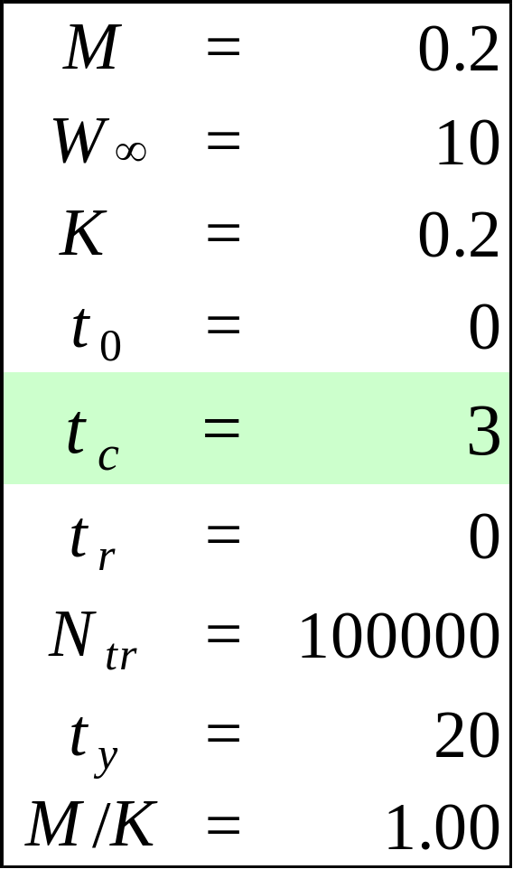
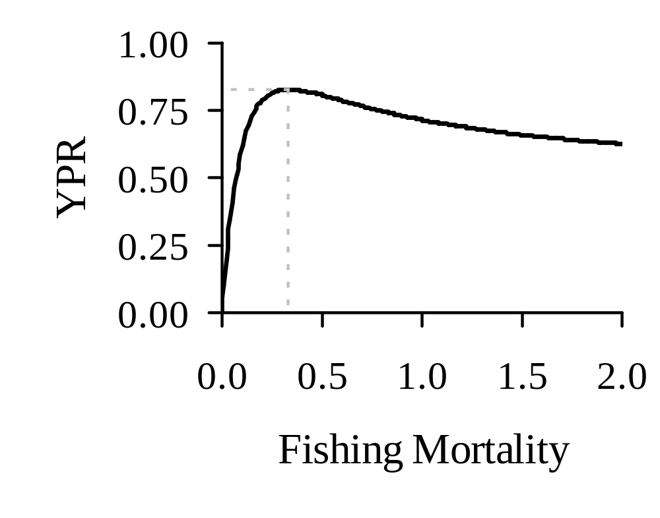
YPR as a Function of Fishing Mortality
YPR_{MAX} = 0.83
F_{MAX} = 0.33

Slide 22

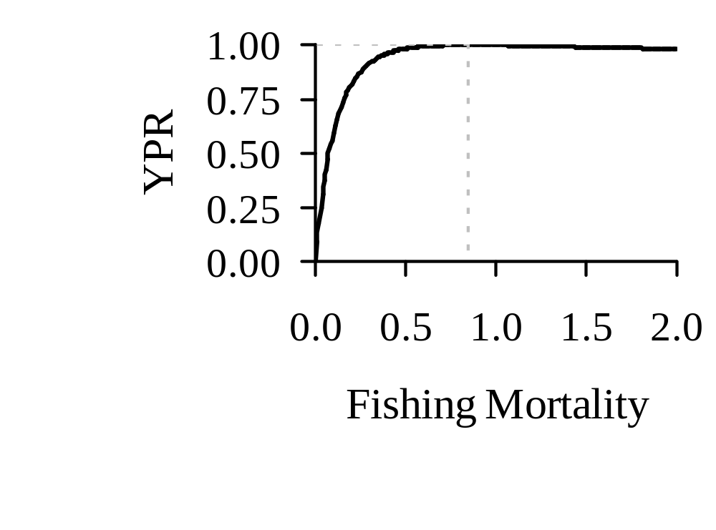
YPR as a Function of Fishing Mortality
YPR_{MAX} = 1.00
20% increase in YPR
F_{MAX} = 0. 85

Slide 23
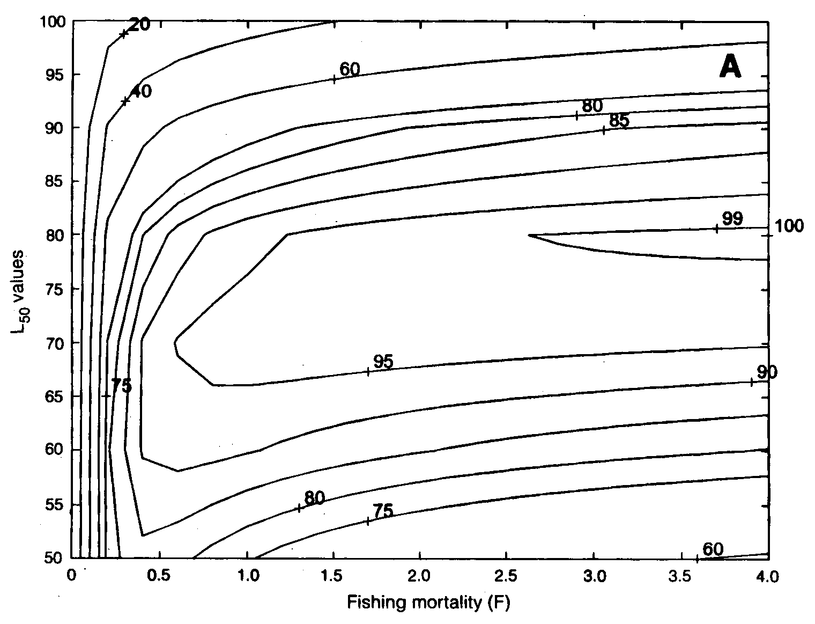
YPR Represented as an Isopleth Diagram

Slide 24
SSBPR Models
Spawning stock biomass per recruit is the cohort biomass remaining after the catch is removed, summed for all years, and divided by the number of recruits.
Spawning stock biomass is a function of F (fishing mortality rate) and the age of entry into the fishery.

Slide 25
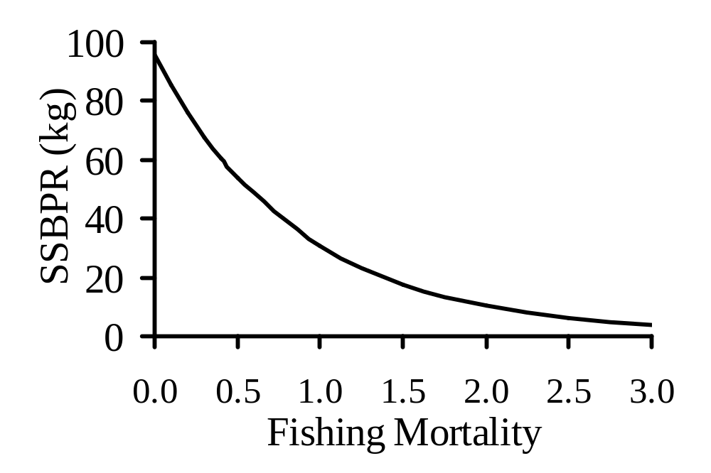
SSBPR as a Function of Fishing Mortality

Slide 26
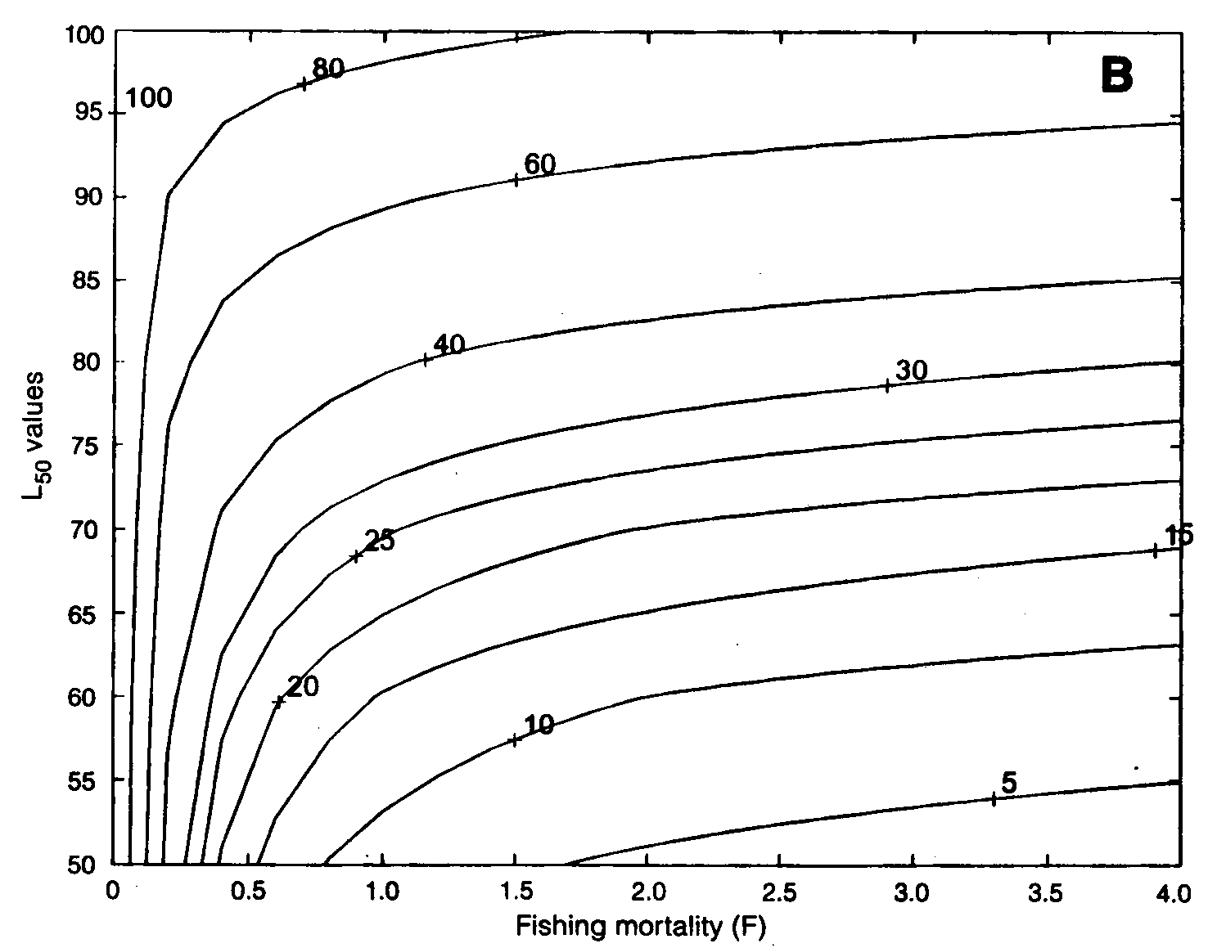
SSBPR Represented as an Isopleth Diagram

Slide 27
Yield and Growth Overfishing Management Reference Points
Y_{MAX} - maximum yield per recruit given a particular age or size of entry into the fishery.
F_{MAX} - fishing mortality rate that results in Y_{MAX} (limit).
F_{0.1} - fishing mortality rate (based on a slope that is 10% of the initial slope) that results in production of 90+% of Y_{MAX} with considerably less effort (target).

Slide 28
Maintaining Reproductive Capacity and Recruitment Overfishing Management Reference Points
F_{5, 10, 20, or 30%} - fishing mortality rate that allows 5, 10, 20, or 30% of the virgin (unfished) spawning stock biomass to be conserved.
F_{target %} is always less than F_{limit %}

Slide 29
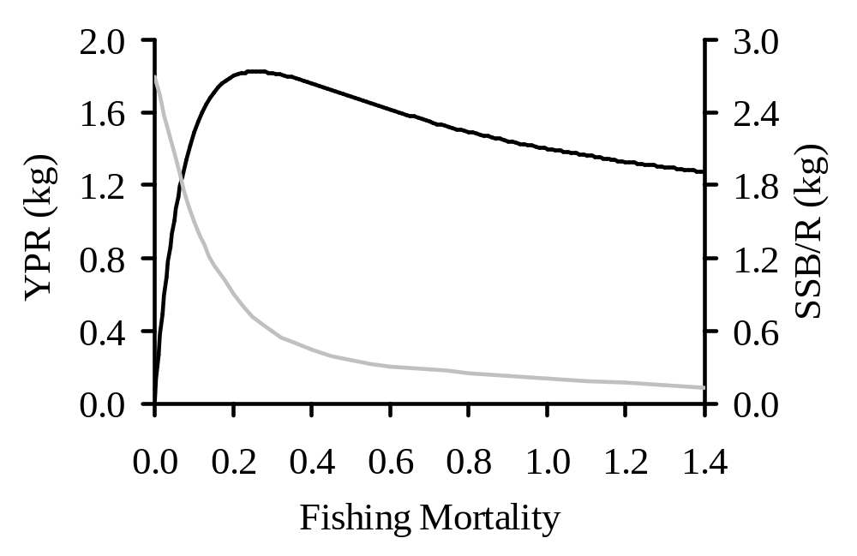
YPR and SSBPR as Reference Points
F_{MAX}
F_{0.1}
F_{20%SSBPR}
F_{10%SSBPR}

Slide 30
Examples of Reference Points from ASMFC Stock Assessments
Blue Crab
American Lobster
Summer Flounder
Bluefish

Slide 31
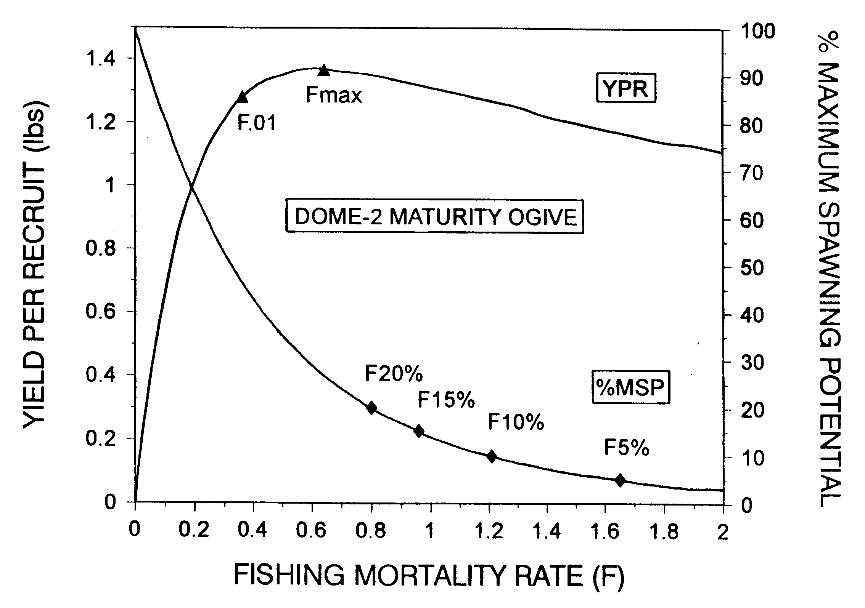
Blue Crab YPR and SSBPR

Slide 32
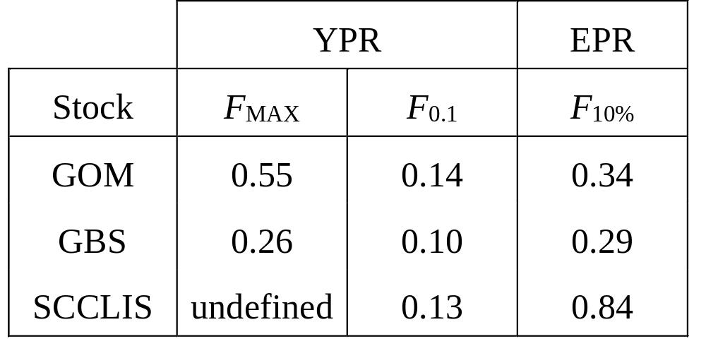
American Lobster Reference Points

Slide 33
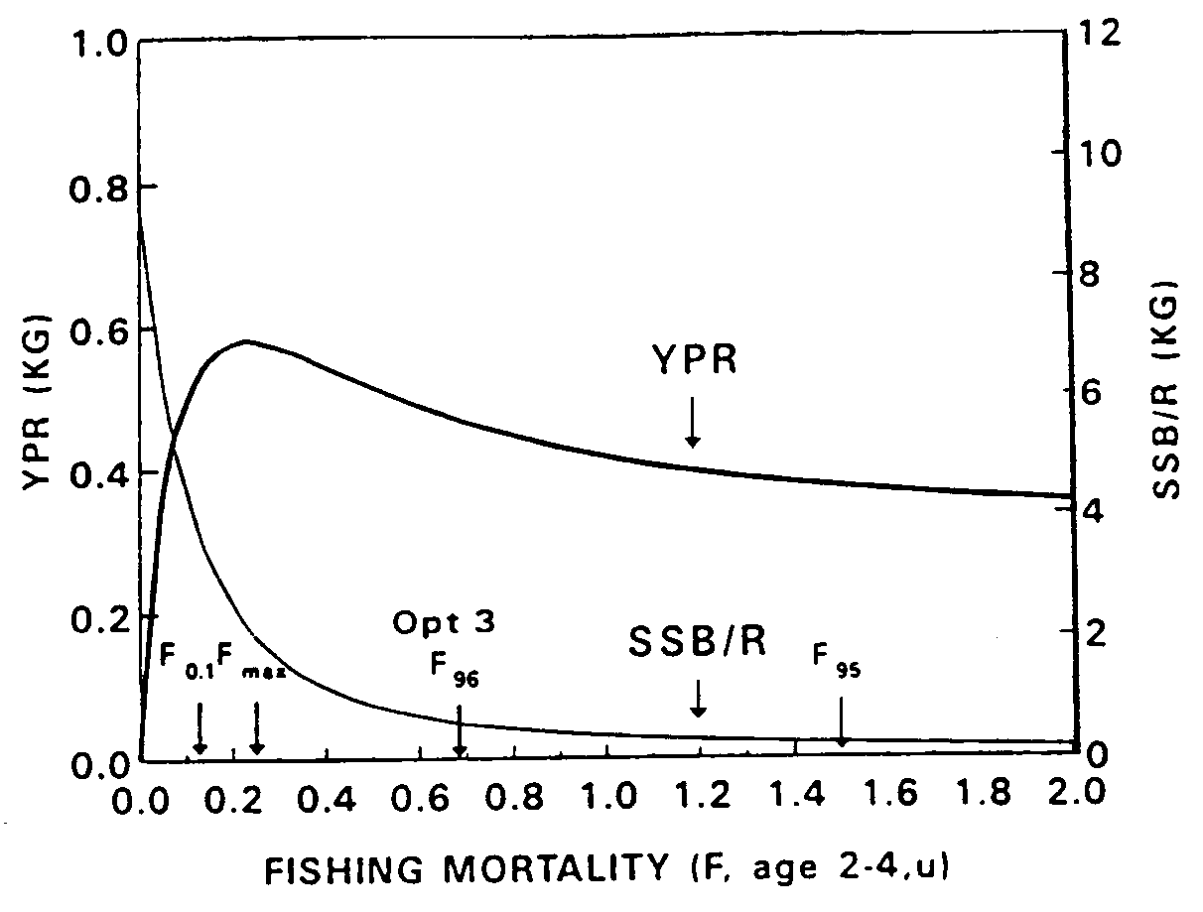
Summer Flounder YPR and SSBPR

Slide 34
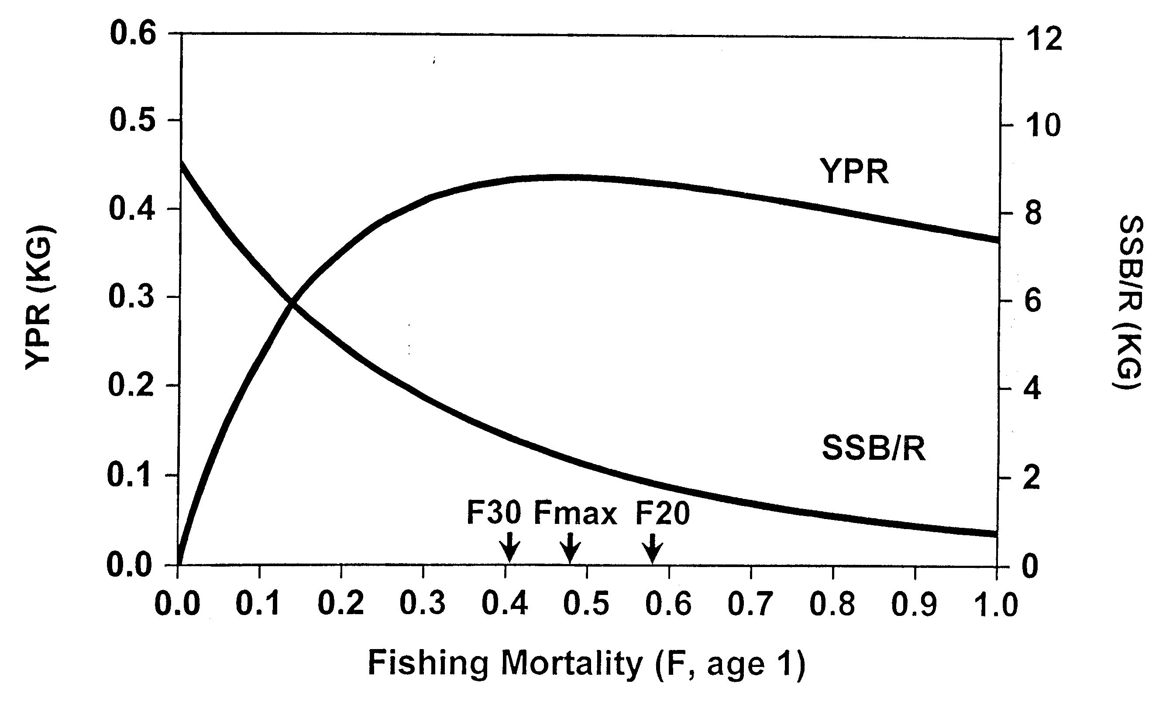
Bluefish YPR and SSBPR

Slide 35
Sensitivity of Reference Points to Model Input Parameters
Effect age or size of entry into the fishery on reference points.
Effect of assumed maturity schedule and longevity on reference points.

Slide 36
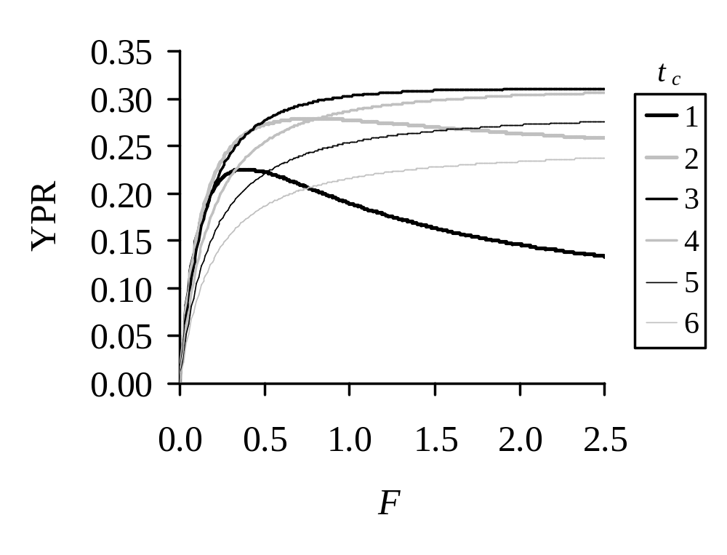
Effect of Age of Entry into the Fishery on YPR Curves of Yellowtail Flounder

Slide 37
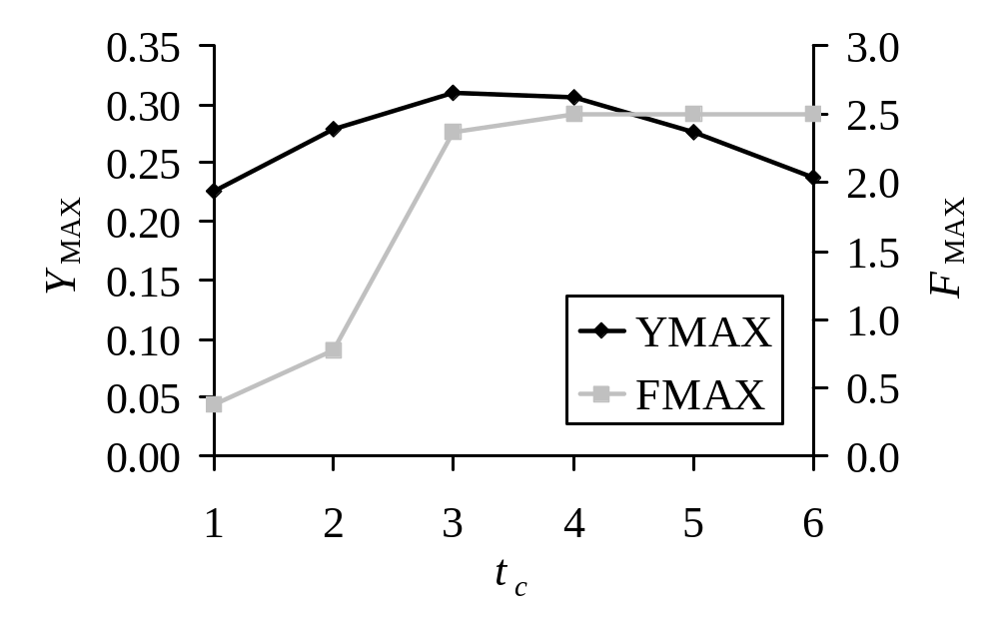
Effect of Age of Entry into the Fishery on YPR Curves of Yellowtail Flounder

Slide 38
Effect of Maturity Schedule on SSBPR for Blue Crab

Slide 39
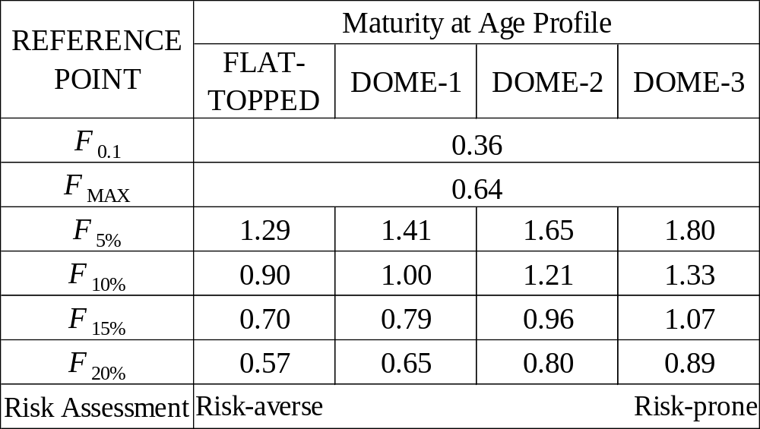
Effect of Maturity Schedule on YPR and SSBPR Reference Points for Blue Crab

Slide 40
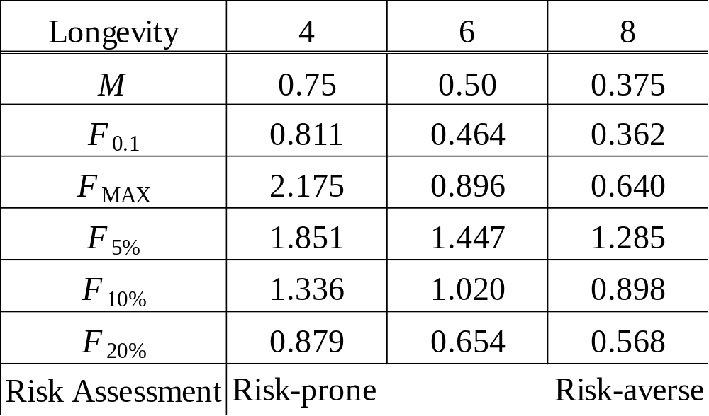
Effect of Longevity or Natural Mortality on YPR and SSBPR Reference Points for Blue Crab

Slide 41
Summary and Conclusions
YPR and SSBPR models provide insight into biological processes and result in reference points to compare present fishing mortality rates against.
YPR and SSBPR models are based on scientific principles.
Input parameters are based on scientific data with uncertainty.
Selection of reference points is based on both science and policy.

